Slide 1

HR Analysis Case

Slide 2
Analysis Procedures Can Be Described As Follow
01
02
03
04
05
Introduction
Data Understanding
Univariate
Analysis
Data
Investigation
Conclusion

Slide 3
01
INTRODUCTION

Slide 4
01
Introduction
Content
This is the HR datasets, every year around 5% of its employees get promoted in the company, so we need to analyze reasons of these promotions from our dataset.
Context
Develop a predictive classifier to predict employee’s promotion on the target variable is_promoted (1 - 0).

Slide 5
02
Data Understanding

Slide 6
02
Data Understanding
Resource
Kaggle Website and here is the link of the dataset :
https://www.kaggle.com/datasets/shivan118/hranalysis?select=train.csv
About the dataset
The dataset consists of (54808) rows and (14) columns.
The dataset include numerical and categorical features.
The business Problem is a classification problem.

Slide 7
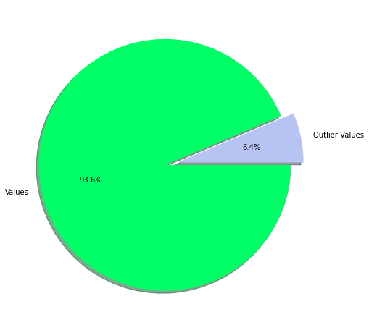
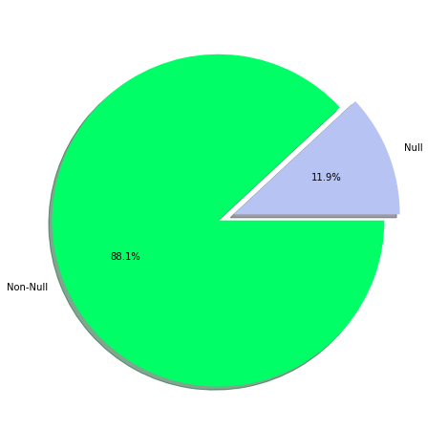
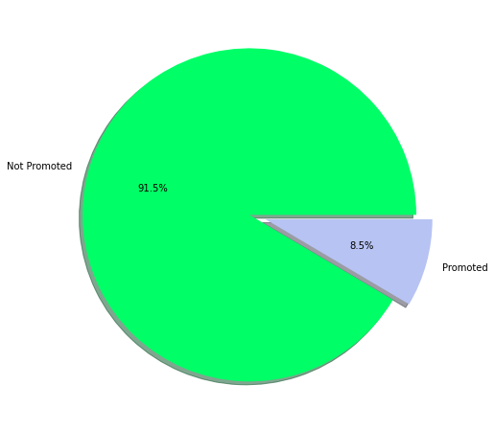
02
Data Understanding
Data Problems
Outliers
Missing Values
Imbalanced

Slide 8
03
Univariate Analysis

Slide 9
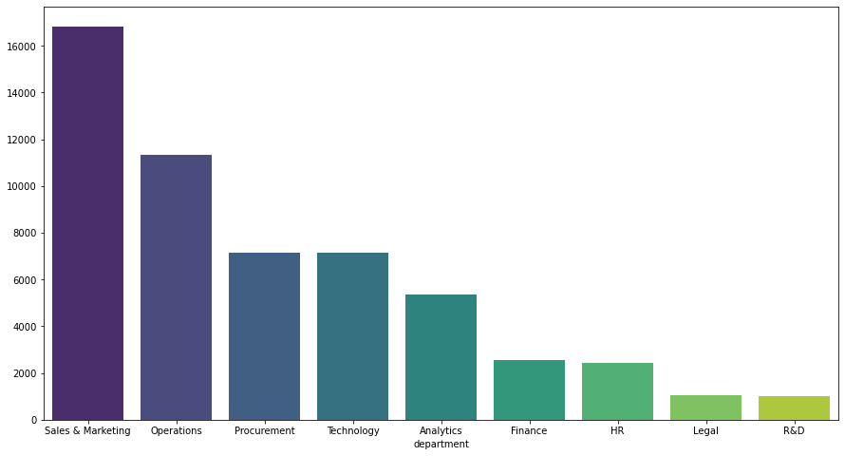
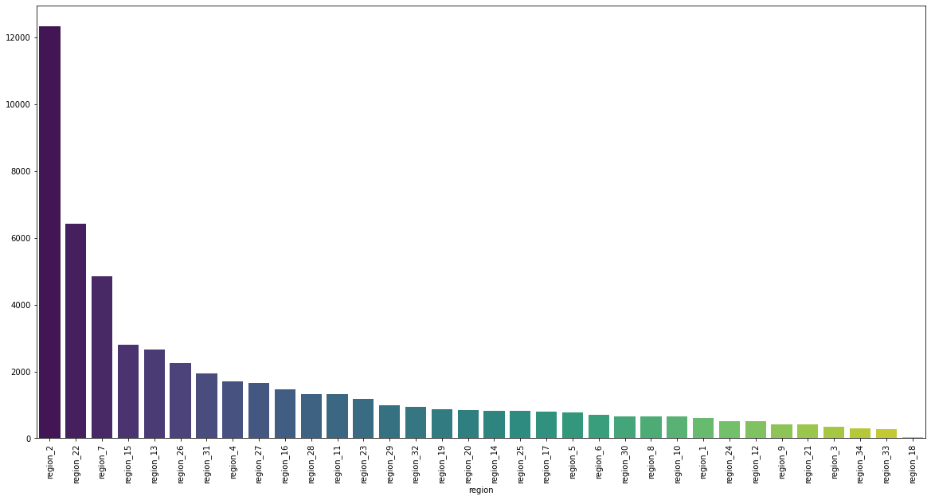
03
Univariate Analysis
Department
Region

Slide 10
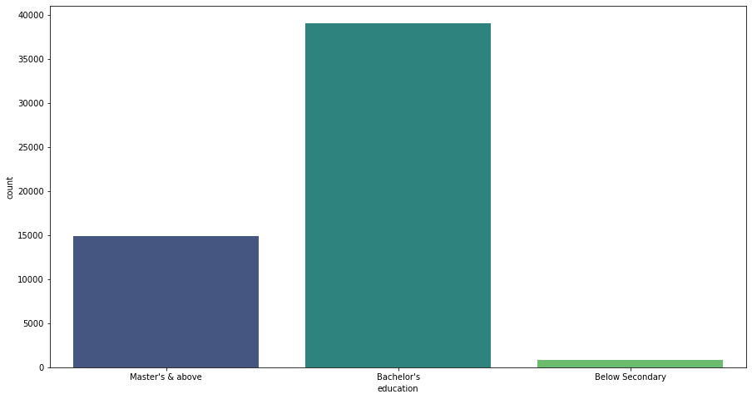
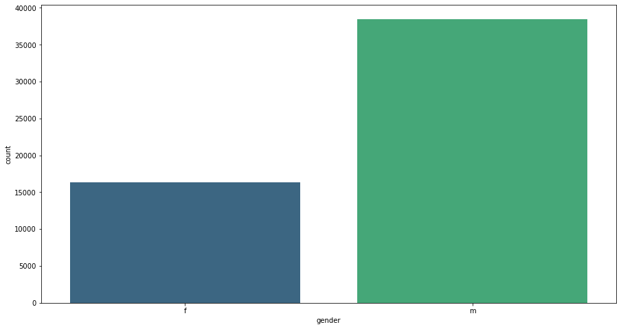
03
Univariate Analysis
Education
Gender

Slide 11
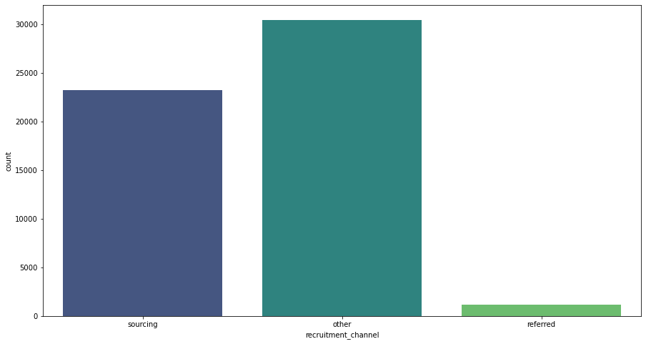
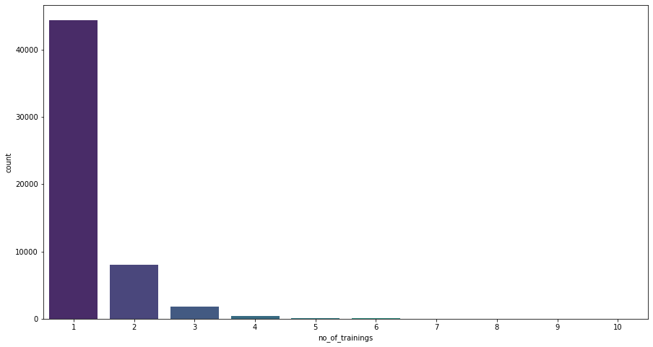
03
Univariate Analysis
Recruitment channel
no of trainings

Slide 12
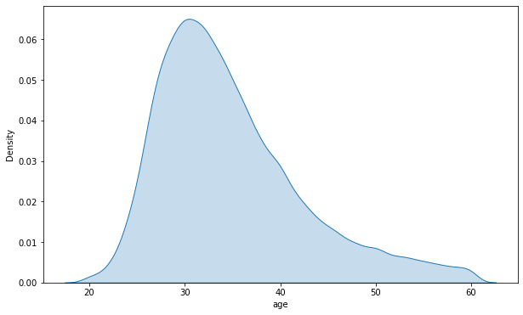
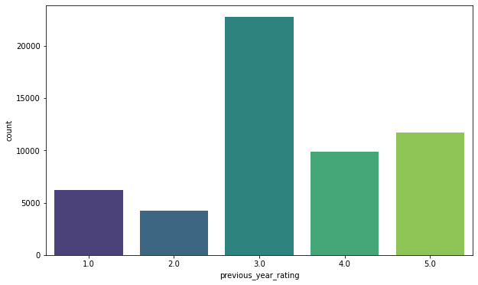
03
Univariate Analysis
Age
Previous year rating

Slide 13
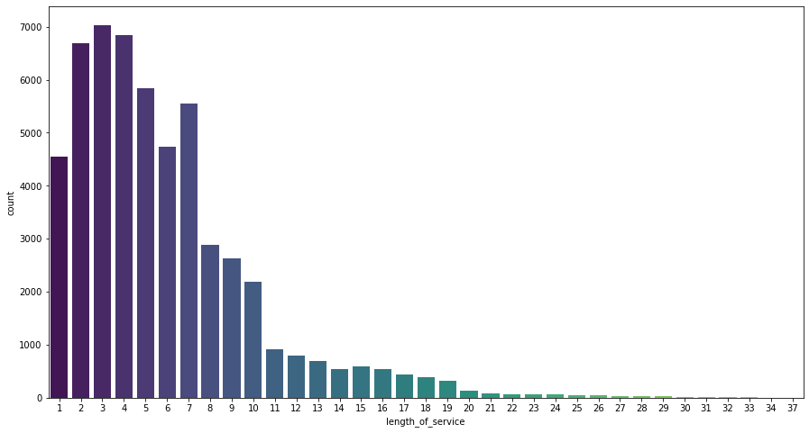
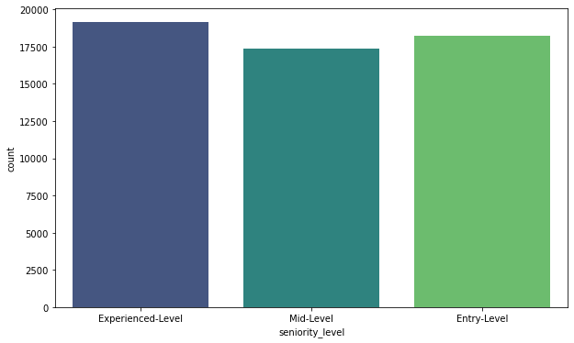
03
Univariate Analysis
Length of service
Seniority level

Slide 14
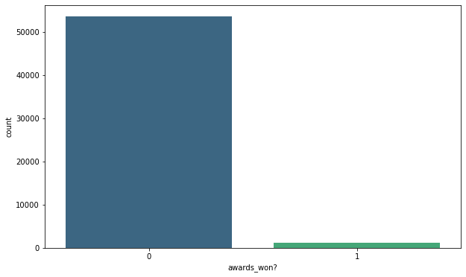
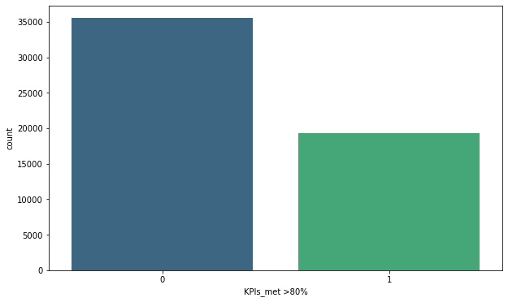
03
Univariate Analysis
Awards won ?
KPI’S_met (> 80%)

Slide 15
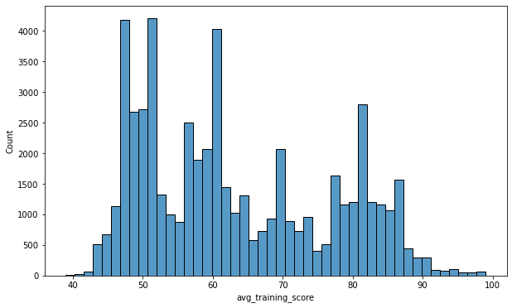
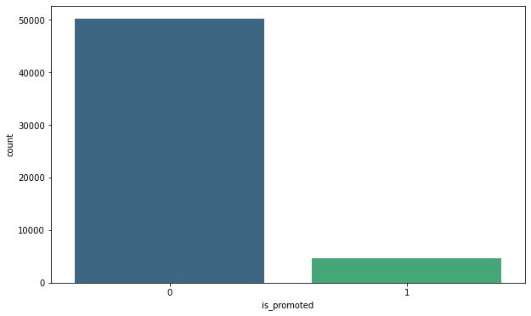
03
Univariate Analysis
Avg training score
Is_promoted

Slide 16
04
Data Investigation

Slide 17

04
Data Investigation
Employee attributes
Employee performance
Age
Gender
Education
Region
Department
No of trainings
Avg training score
KPI
Awards won
Previous year rating

Slide 18
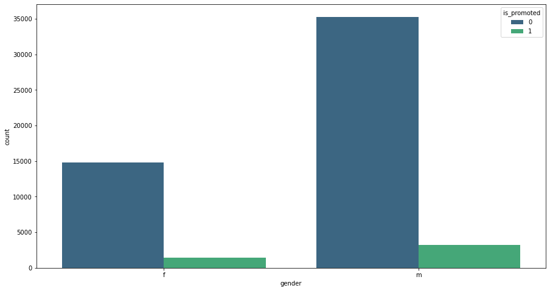
04
Data Investigation
Employee attributes
(Gender)

Slide 19
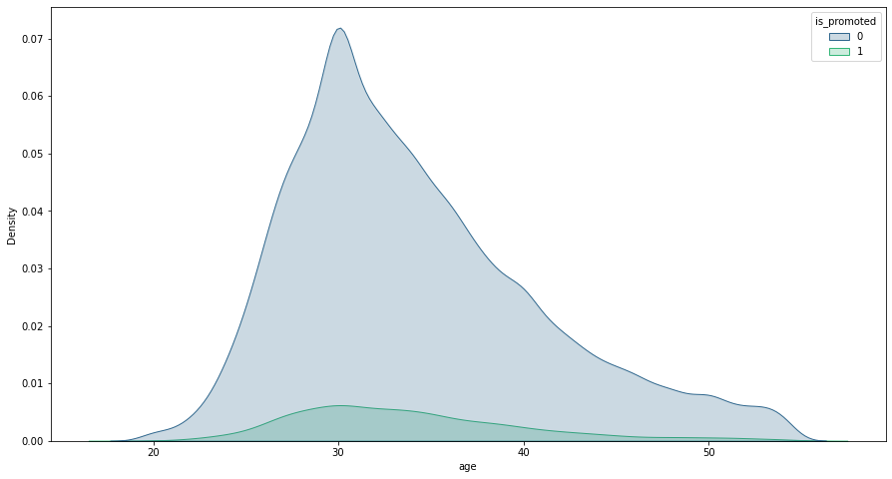
04
Data Investigation
Employee attributes
(Age)

Slide 20
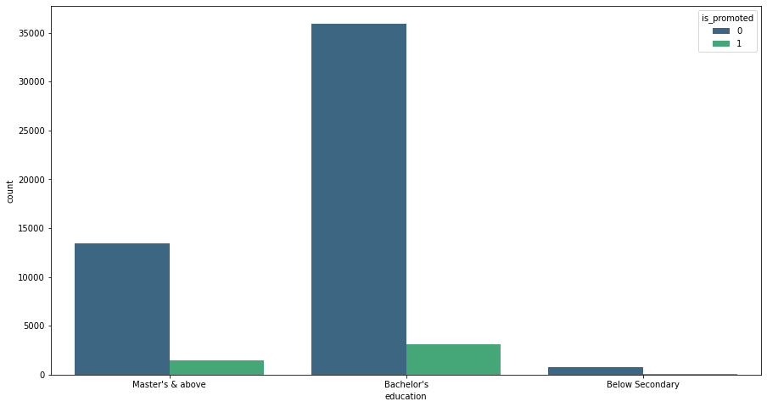
04
Data Investigation
Employee attributes
(Education)

Slide 21
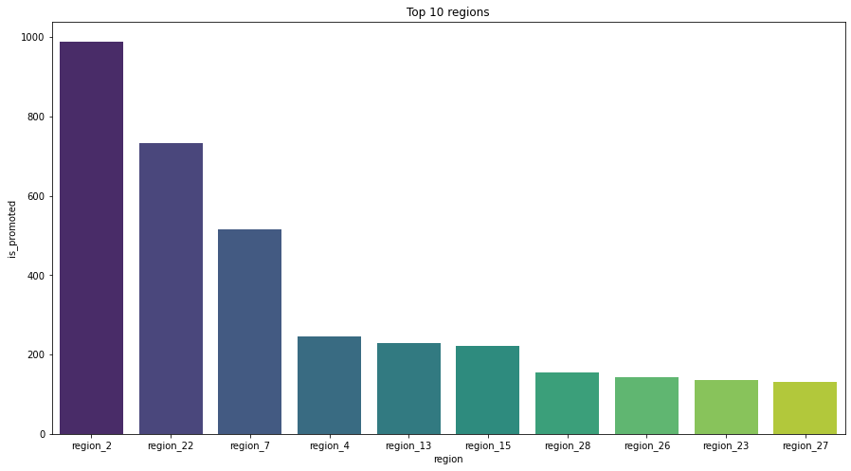
04
Data Investigation
Employee attributes
(Region)

Slide 22
04
Data Investigation
Employee attributes
(Department)

Slide 23
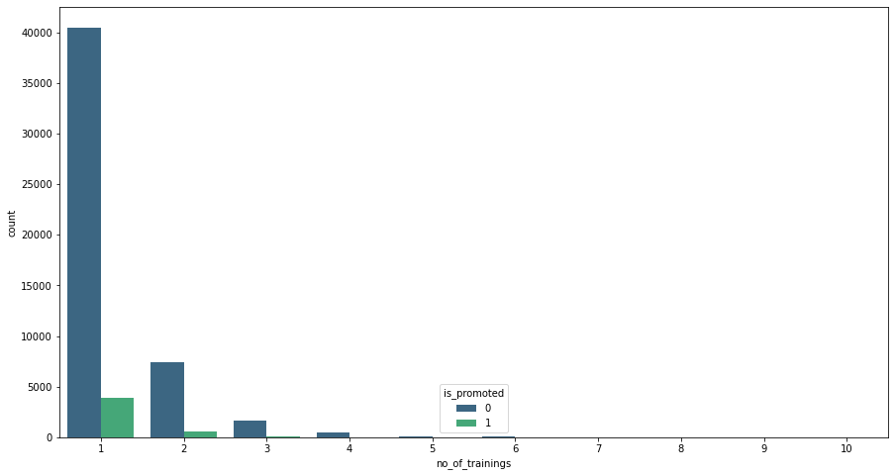
04
Data Investigation
Employee Performance
(No of trainings)

Slide 24
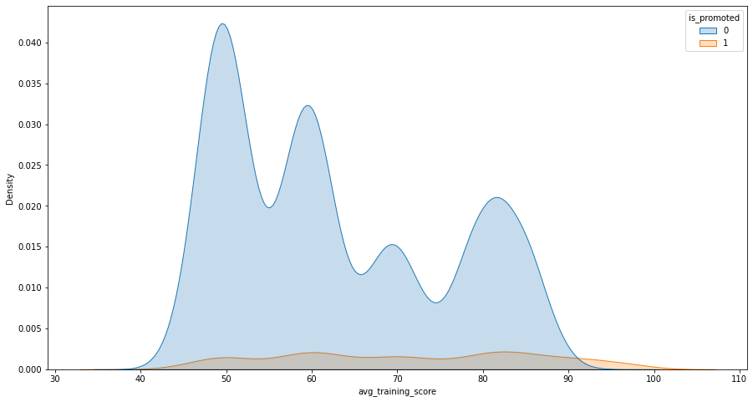
04
Data Investigation
Employee Performance
(Avg training score)

Slide 25
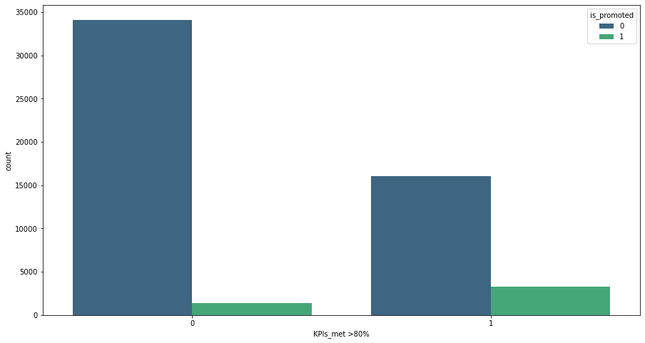
04
Data Investigation
Employee Performance
(KPI)

Slide 26
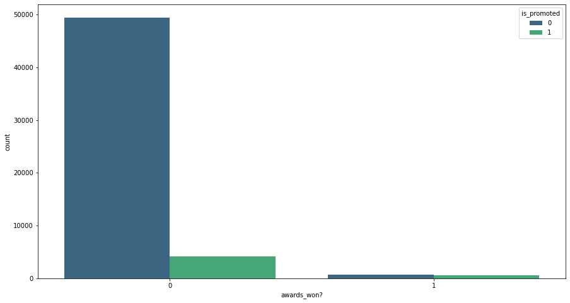
04
Data Investigation
Employee Performance
(Awards won?)

Slide 27
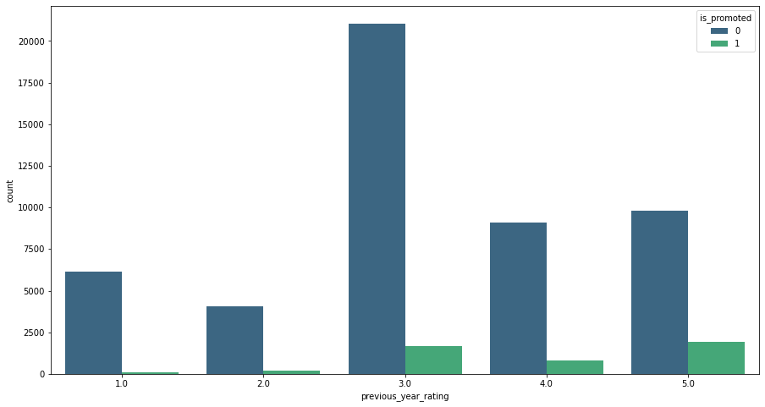
04
Data Investigation
Employee Performance
(Previous year rating)

Slide 28
05
Conclusion

Slide 29
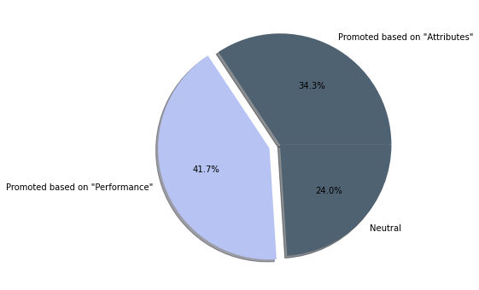
05
Conclusion
Employees get promoted based on attributes or performance ?
We can come to a conclusion after the analysis that the majority of the
employees get promoted based on their high performance regardless of the
employee attributes.

Slide 30
THANK YOU

